Slide 1
Quality review
UI design and functions(web-based management)

Slide 2
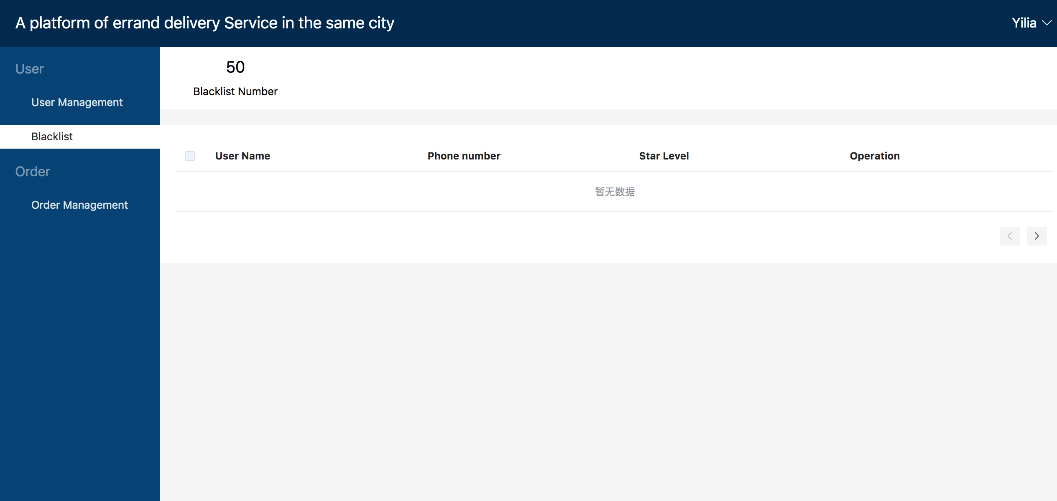

Slide 4
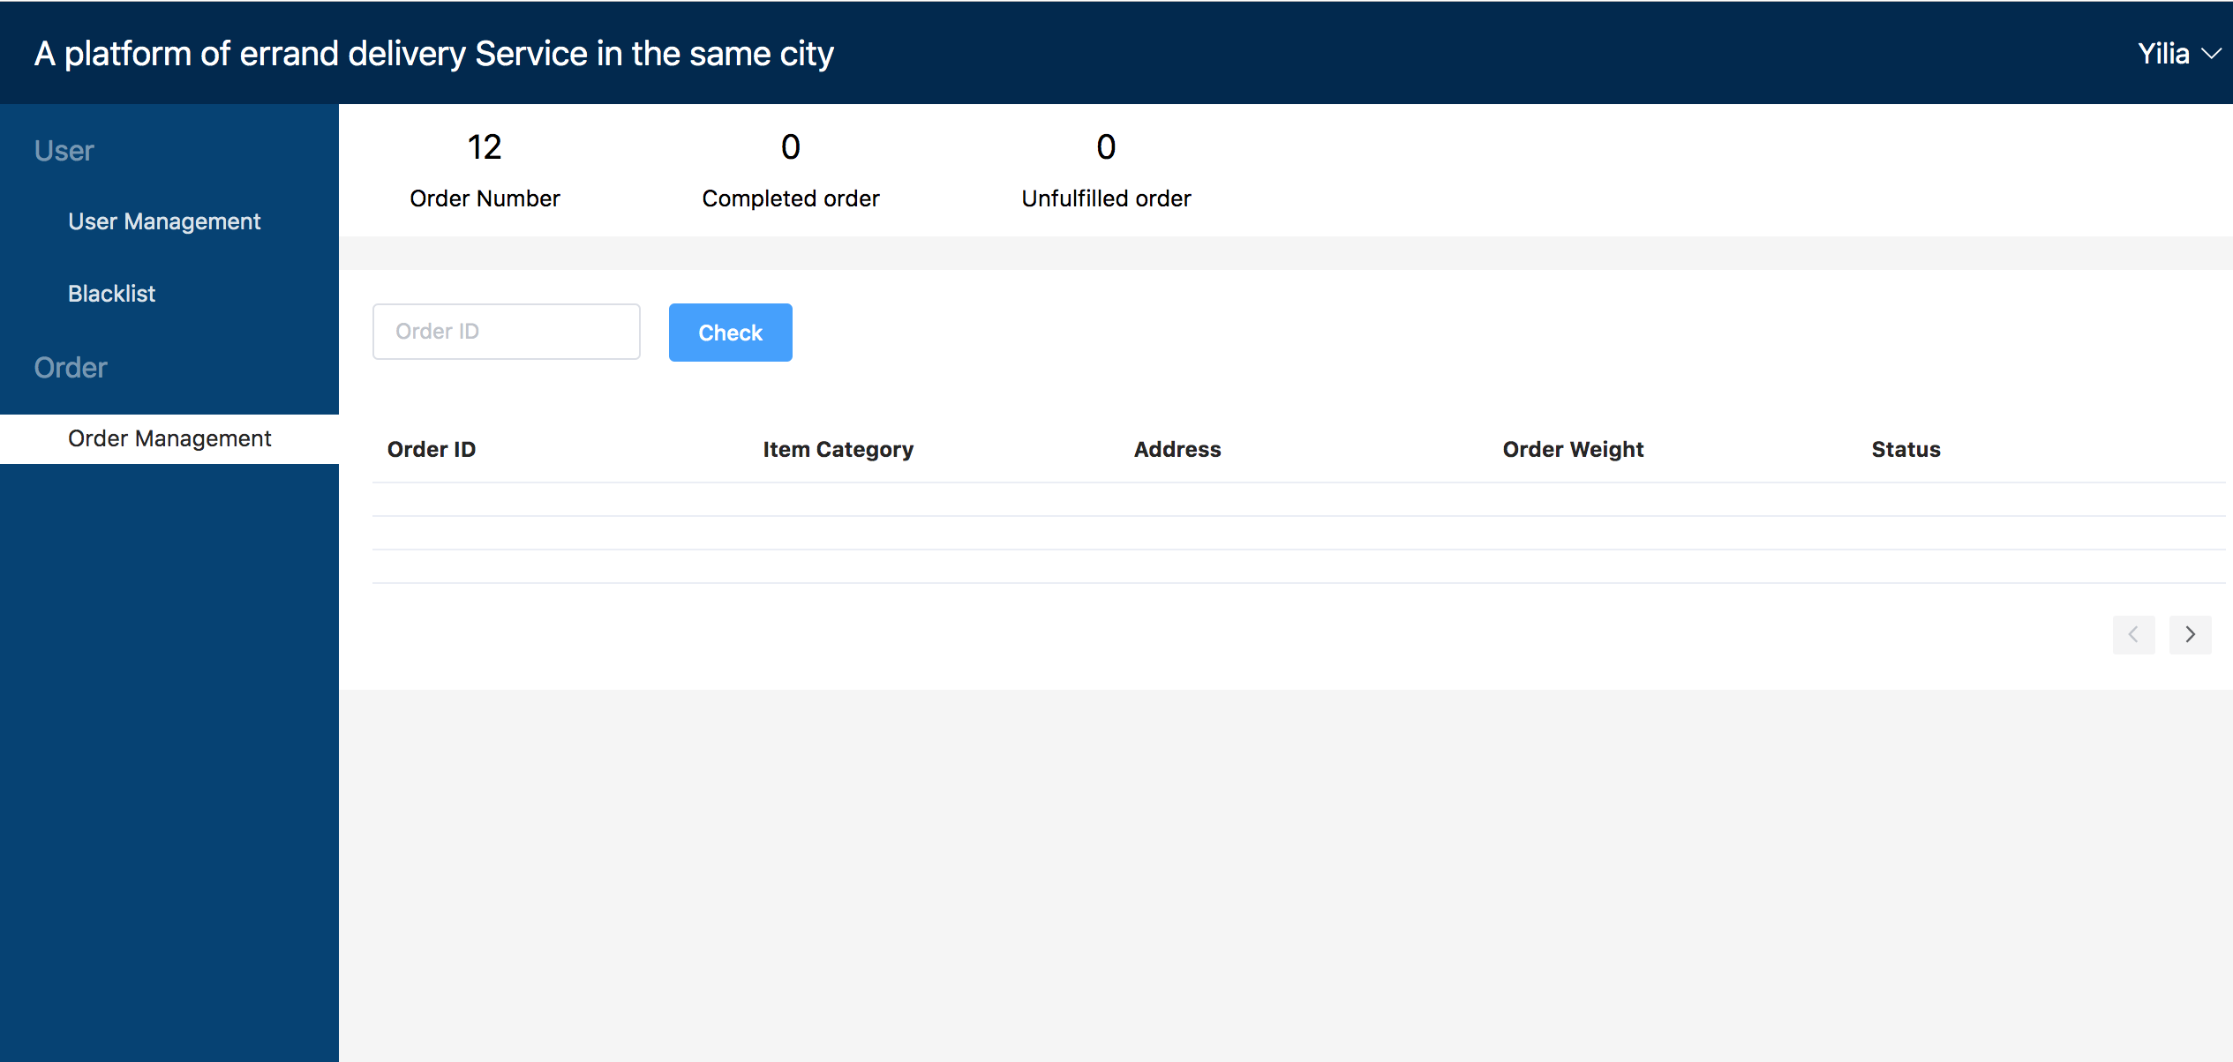

Slide 5
Thanks for your time
UI design and functions(web-based management)

